Slide 1
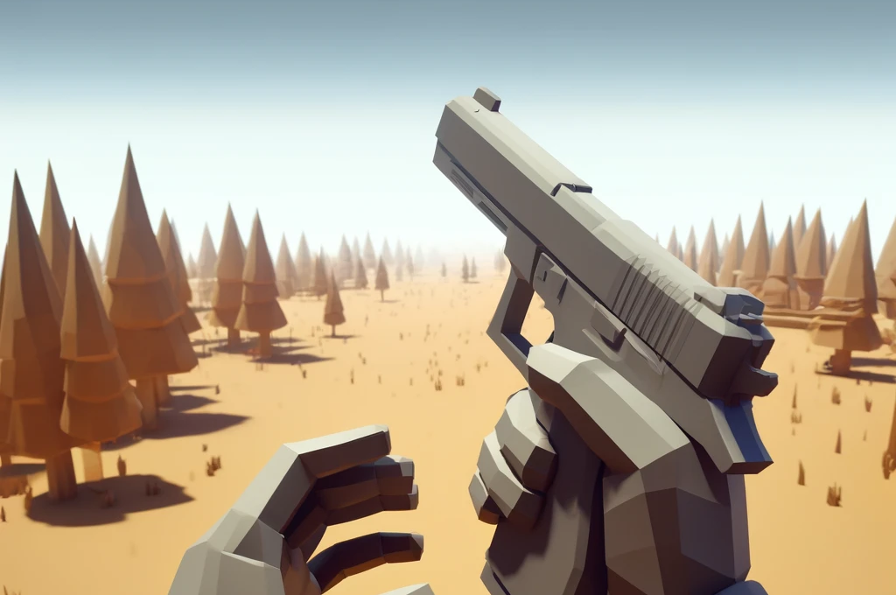
Unlocking Game Development
A Beginner's Journey with Unity and .NET
Software Engineering | Digital Transformation
Neil Thompson | November 2024

Slide 2

About
me
That‘s me
Part of Accso since 2022
Managing Consultant
Full stack dev, Architect, Project Manager
Wife and 2 kids, 1 Girl & 1 Boy
Loves exercise, Gaming and Programming

Slide 3

Notes:
Sponsors

Slide 4

Notes:
Unified Platform – Develop Anything – Generated by ChatGPT

Slide 5
Agenda
Part 1: Why Unity?
Part 2: Unity Basics and Core Concepts
Part 3: Resources, Pricing, Repositories
Part 4: DEMO – Create a Game
Part 5: Q&A

Slide 6








Part 1: Why Unity?
Why Unity? Unity is one of the most popular game engines in the world—it’s powerful, flexible, and, best of all, approachable for beginners.
In Unity, you can create all sorts of games, from 2D platformers to immersive 3D experiences.
And thanks to .NET and C#, Unity has a strong backbone for logic, structure, and interaction.
Create community with complete documentation and support with years of experience

Slide 7
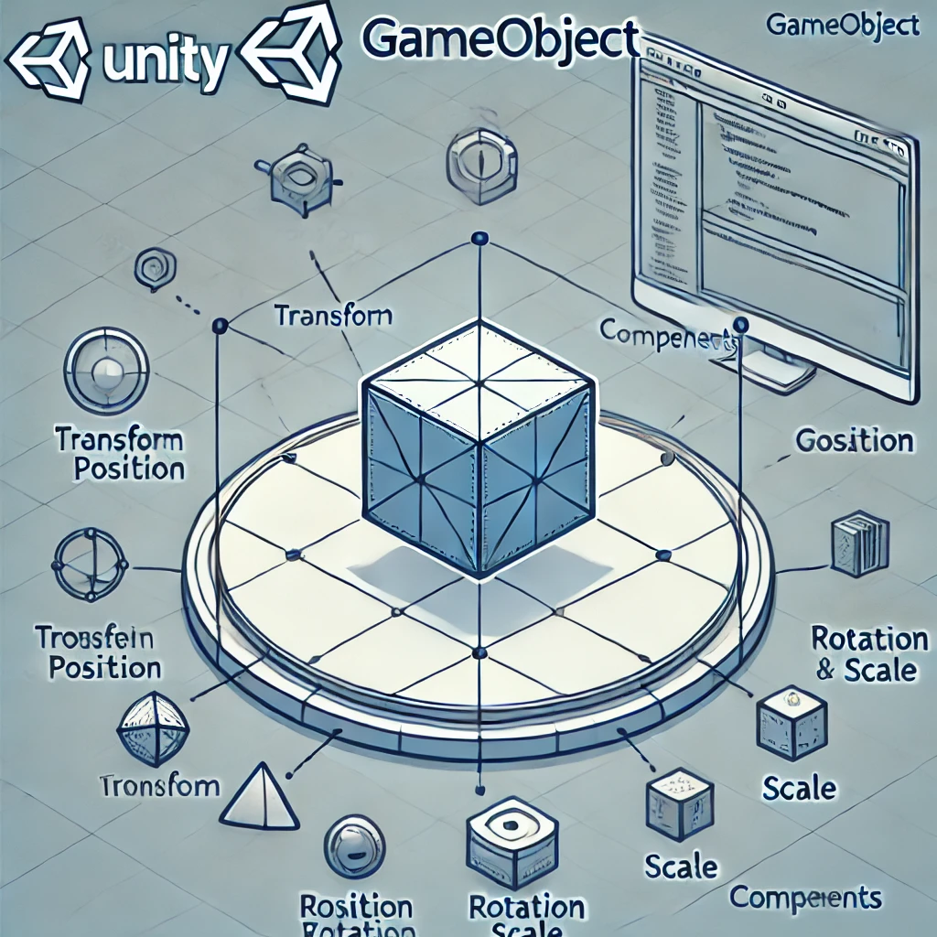
Part 2: Unity Basics and Core Concepts
GameObject
a Term you’ll hear often in Unity.
A GameObject is basically anything
that appears in your game
—like a player character, a tree, or even the
ground they walk on.
GameObjects are the building blocks of a
Unity game.
But GameObjects on their own don’t do much.
You have to add components to them to
give them behaviors, like movement or color.
Components
Scenes, Game View, Inspector
Prefabs
Scripts
https://docs.unity3d.com/Manual/

Slide 8
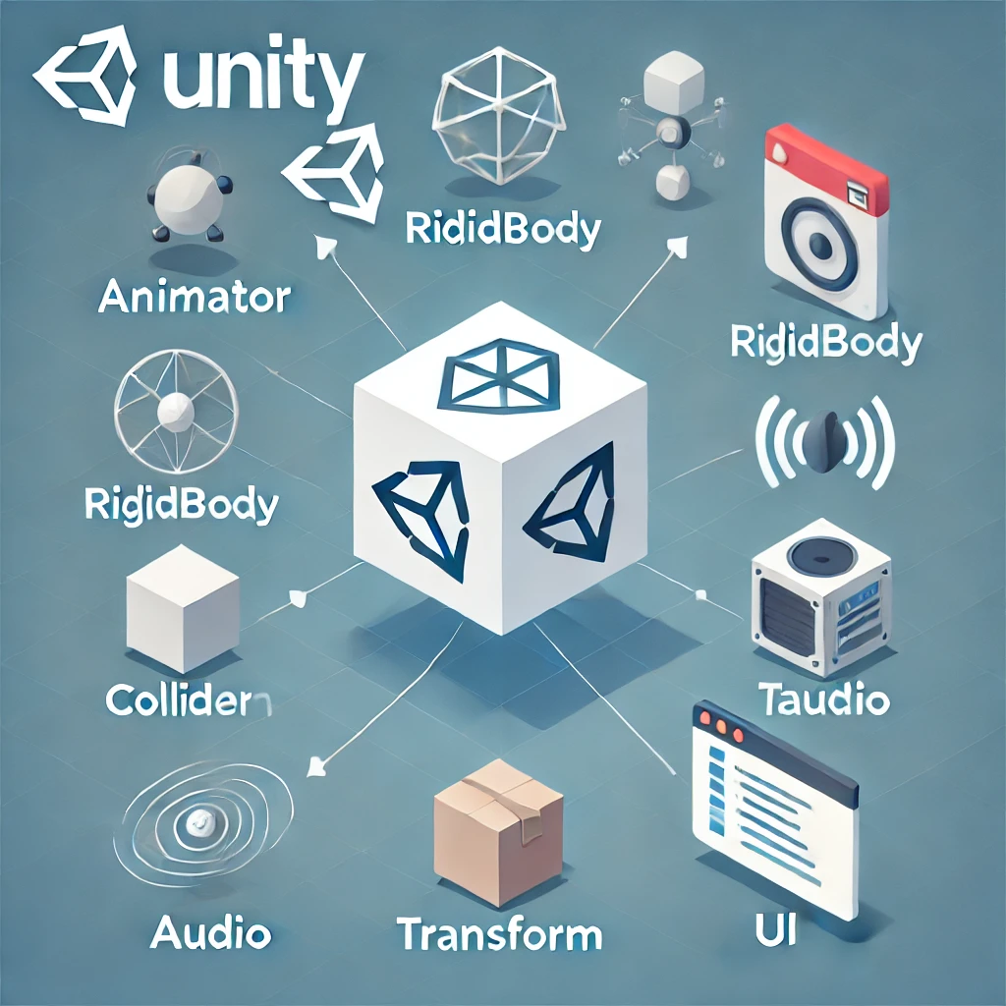
Part 2: Unity Basics and Core Concepts
GameObject
Components: Components are like building blocks for GameObjects. They add functionality to GameObjects. For instance:
Rigidbody: This component adds physics, like gravity, to a GameObject.
Collider: This component lets a GameObject detect and respond to collisions. For example, if a character runs into a wall, a Collider can stop them from going through it.
Think hitboxes for players
Transform: This component determines the Position, Rotation, and Scale of each object in the scene
Components
Scenes, Game View, Inspector
Prefabs
Scripts
https://docs.unity3d.com/Manual/

Slide 9
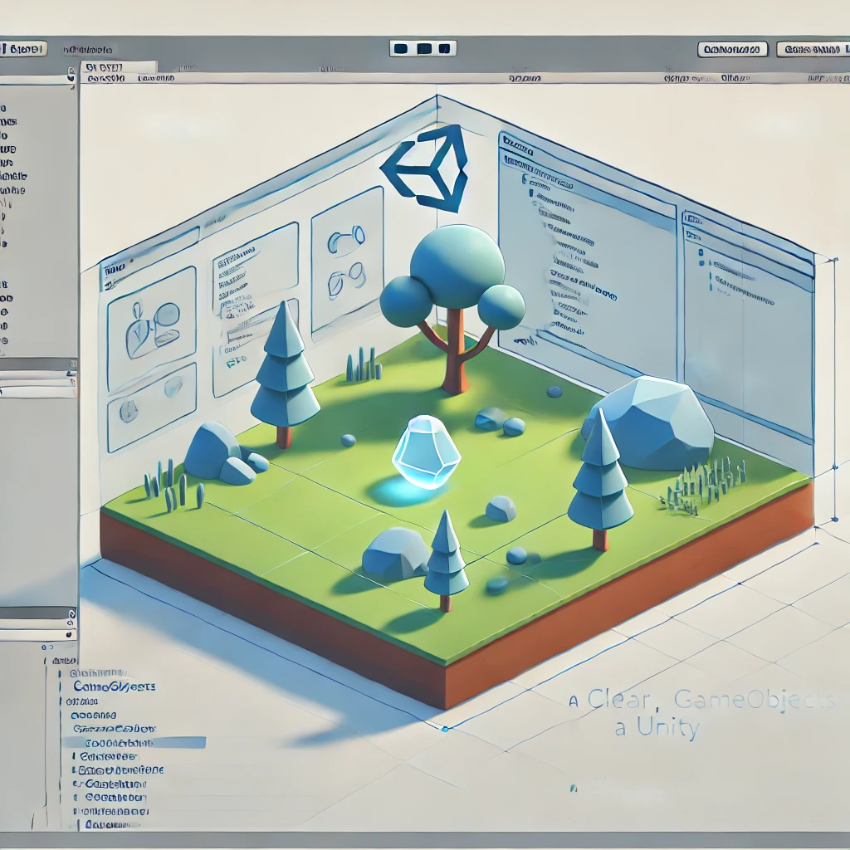
Part 2: Unity Basics and Core Concepts
GameObject
Scene: A Scene is like a level or area in your game.
You can think of it as a “space” where GameObjects exist.
A game can have multiple scenes—one for each level, for instance.
Scene View: Is where you can manipulate the “level”. You can also manipulate this during runtime but it will not save the state
Game View: is where you see the game as it would appear to a player. (Camera View)
Inspector: panel lets you adjust settings for different elements in your game. GameObjects
Components
Scenes, Game View, Inspector
Prefabs
Scripts
https://docs.unity3d.com/Manual/

Slide 10
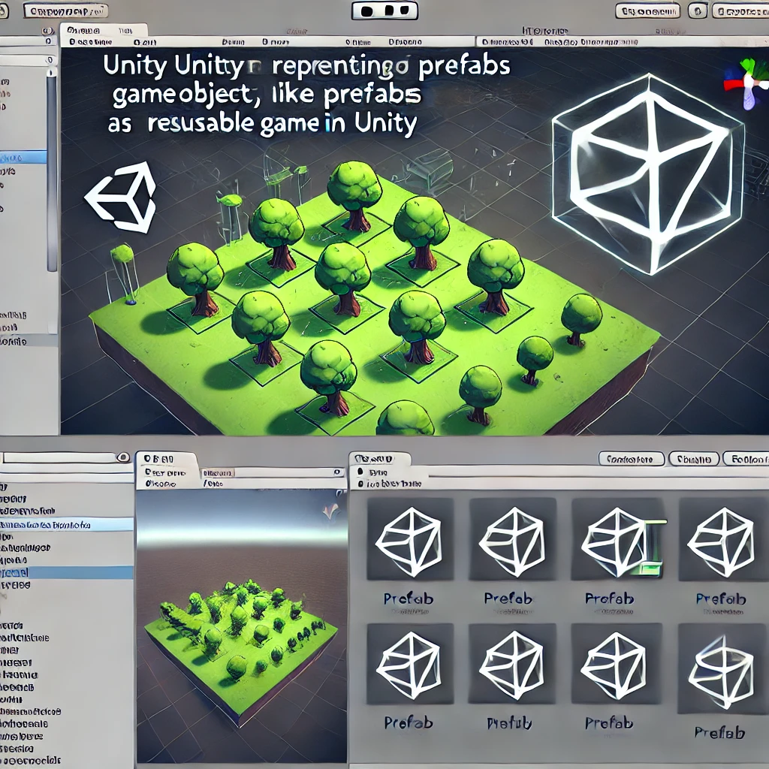
Part 2: Unity Basics and Core Concepts
GameObject
Prefabs: A Prefab is a reusable template for GameObjects.
For example, if you want to create multiple identical enemies in a game, you can create one Prefab of an enemy, then make copies.
Any changes to the Prefab will apply to all copies.
Components
Scenes, Game View, Inspector
Prefabs
Scripts
https://docs.unity3d.com/Manual/

Slide 11

Part 2: Unity Basics and Core Concepts
GameObject
Unity uses C# for scripting, leveraging .NET libraries to manage game logic.
MonoBehaviours: Is the base class for most scripts and allows interaction with Unity’s game loop and lifecycle hooks key methods within MonoBehaviour:
Start() – Initialization method, runs once when the GameObject is active.
Update() – Runs every frame, ideal for code that continuously checks conditions, moves objects, etc.
.NET’s Role:.NET and C# provide structure, object-oriented principles, and a vast ecosystem of libraries to manage game state, character stats, inventory, and more.
Components
Scenes, Game View, Inspector
Prefabs
Scripts
https://docs.unity3d.com/Manual/

Slide 12

Part 3: Resources, Repositories, and Pricing
Learning Resources
Unity Learn: Free tutorials and projects for beginners.
Microsoft Learn: Official documentation and tutorials on .NET and C#.
https://www.youtube.com/@Brackeys/videos
Repositories and Community
GitHub: Search for open-source Unity and .NET game templates for inspiration
Unity Asset Store: Find free and premium assets to streamline development.
Unity Pricing
Unity Personal: This plan is available to customers with up to $200,000 in revenue and funding – Always Free
Unity Pro: While this plan is available to all, it is required for customers with $200,000 or more in revenue and funding.
2025 - $2,200/yr per seat, prepaid yearly or $200/mo per seat, paid monthly
Unity Enterprise: While this plan is available to all, it is required for customers with $25 million or more in revenue and funding.
2025 - Custom pricing : A minimum subscription requirement may apply.
https://unity.com/products

Slide 13
Part 4: Creating a Simple FPS Game (DEMO)
Notes:
Creating and Optimizing a Simple FPS Game Objective: Build a small FPS game with core mechanics, integrating optimizations along the way. Import Cartoon low poly tree Game Overview: This simple FPS game will include player movement, aiming, shooting mechanics, enemy AI, and score tracking. We'll implement object pooling to optimize bullet handling, and use lightweight colliders and other best practices to ensure smooth performance.

Slide 14
Part 5: Q&A

